Slide 1

Python As An Additional Language
Lesson 6: Having a REST

Slide 2
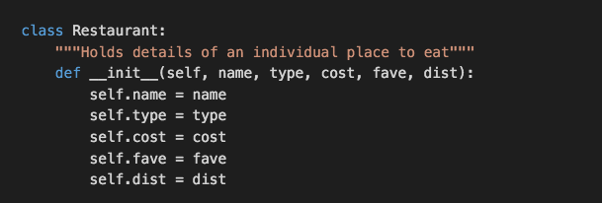

Last time
Instance methods always take the current instance as the first argument.

Slide 3
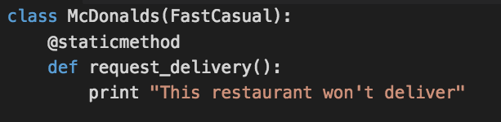
Would I lie to you?
We can use decorators to declare static methods.
Static methods belong to an object but don’t have access to its properties.
Other decorators are also available – notably @classmethod (used to create Factories)
Notes:
I’m not going to go further into decorators or class methods; we only have so much time.

Slide 4
JSON: JavaScript Object Notation
Common form of data encoding
Allows us to create more complex data structures than CSV
Uses similar data structures to Python:
Strings
Integers and floats
Lists
Dictionaries

Slide 5
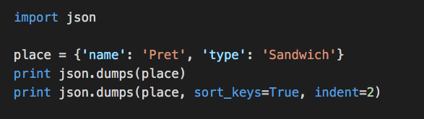
Getting to know JSON

Slide 6
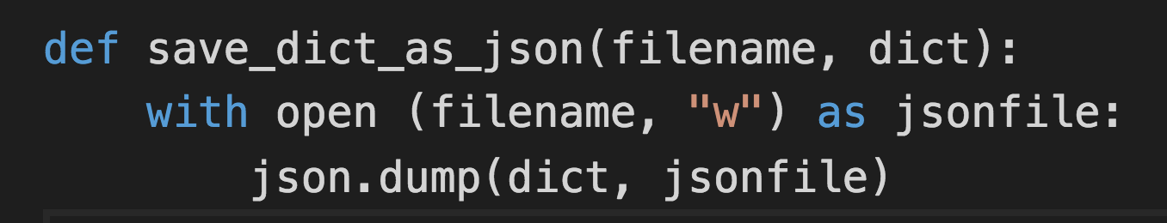
Interacting with files

Slide 7
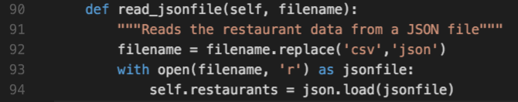
Doing the opposite

Slide 8
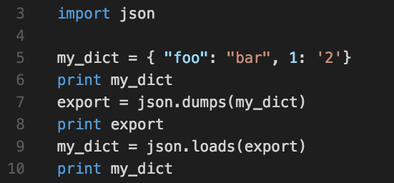
Beware!
What you put into JSON might not be the same when it comes back:

Slide 9
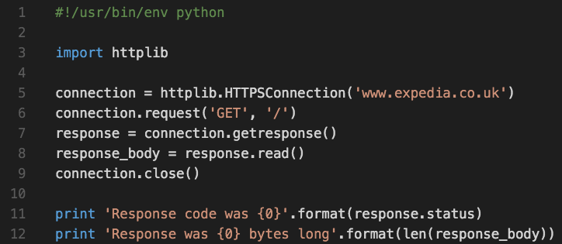
And now for something completely different

Slide 10
And now for something completely different
The equivalent in Python of typing https://www.expedia.co.uk/ into your browser.

Slide 11
HTTP: HyperText Transmission Protocol
Too complicated to cover the entire protocol
Google RFC2616 if you’re bored or need some bedtime reading
In short, we send:
a verb (usually GET, PUT, POST or DELETE)
A path ( ’/’ is the root path – you’ve seen these in URLs)
Some other stuff we don’t need to care about right now
We get back:
A response code (‘200’ means ’OK’)
Some content (usually)
Some other stuff we don’t need to care about right now

Slide 12
When RESTing is desirable
REST: Representational State Transfer
A way for computer programs to use HTTP to manipulate data
JSON is frequently used to encode the data
REST can be used to access a bunch of tools used internally:
SMART (Netscalers)
Seiso (EWE CMDB)
Trello
JIRA
But they’re boring. Let’s look at something a bit flashier.

Slide 13
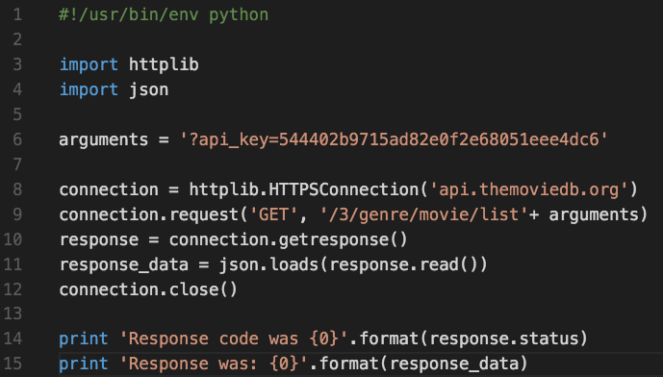
Genre-defying code

Slide 14
Exercise
Fetch the list of genres from The Movie DB
Display them for the user, and ask them to choose a genre
Display a list of movies belonging to that genre
Hints:
You must always supply an API key (if you’re able to, get your own)
/3/genre/<genre id>/movies will give data about movies belonging to that genre

Slide 15
Extra credit
Refactor your code, so that you don’t have repeated HTTPSConnection statements
As well as the title of the films, print their production budget out
Order the output in order of budget, highest budget film first
http://docs.themoviedb.apiary.io/ may help

